Slide 1

Analytics Suggests:
How to get hired?
Persuasive Presentation
Priyanka Nagpal
PN2357

Slide 2

10641 Jobs 2344 Companies
50 States 24 types of skillsets
“Data Scientists & Data Analysts are need of the hour”

Slide 3
Choose data source
Plenty of open live data sources available
10,641 jobs data was scraped from LinkedIn for this analysis
Most Relevant Questions:
Top Hirers for Data Scientists & Data Analysts
Locations for such jobs
Skillset Required

Slide 4
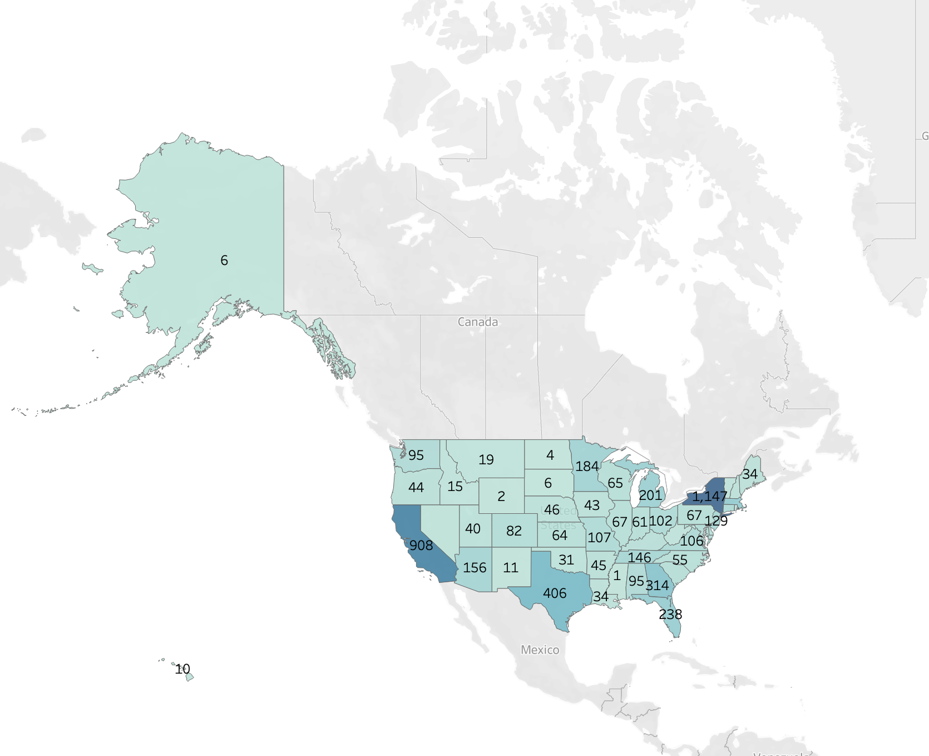
60% Jobs are for Data Scientists & Data Analysts
Top 5 states as per this data for such roles are:
New York(19.39%)
California(15.%)
Texas(6.8%)
Georgia(5.3%)
Massachusetts(4.1%)
Data Source: https://www.linkedin.com/jobs

Slide 5
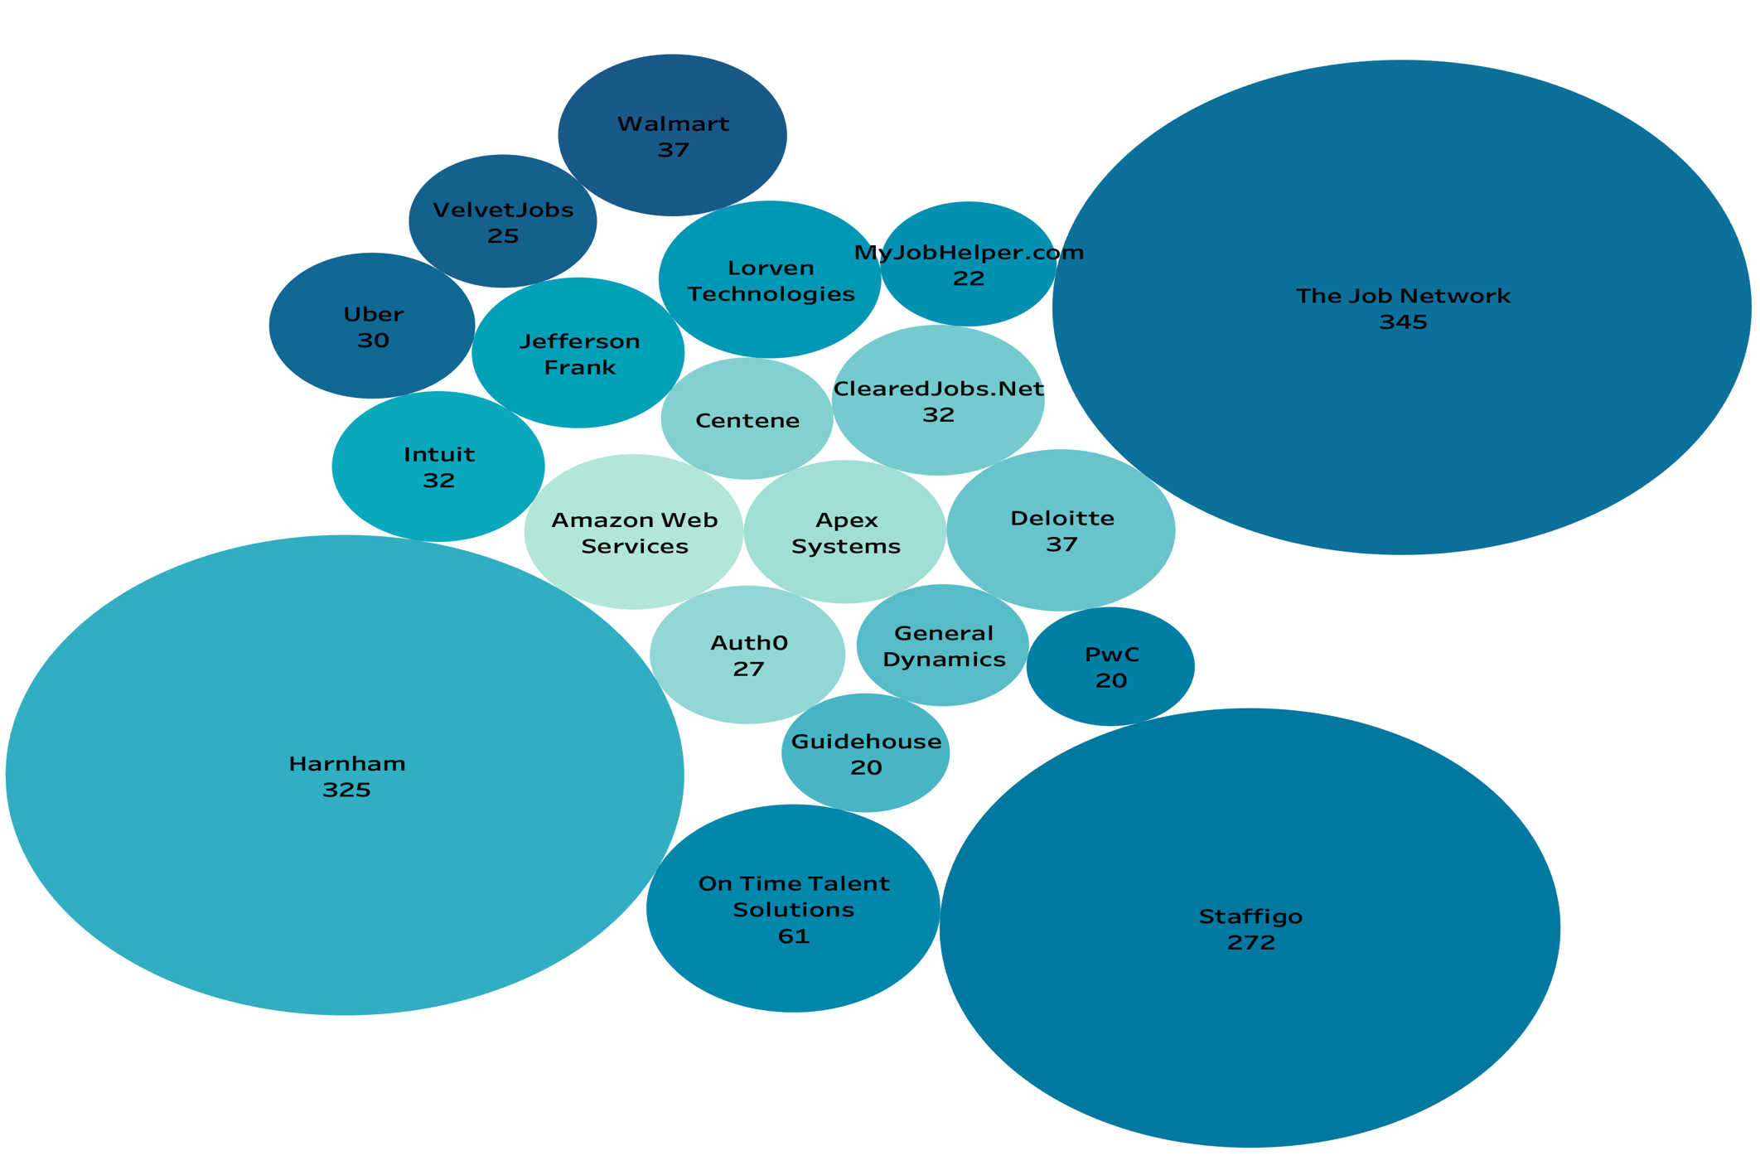
2,344 different Companies are looking for such type of roles
Graph represents Top 20 recruiters list
Data Source: https://www.linkedin.com/jobs

Slide 6
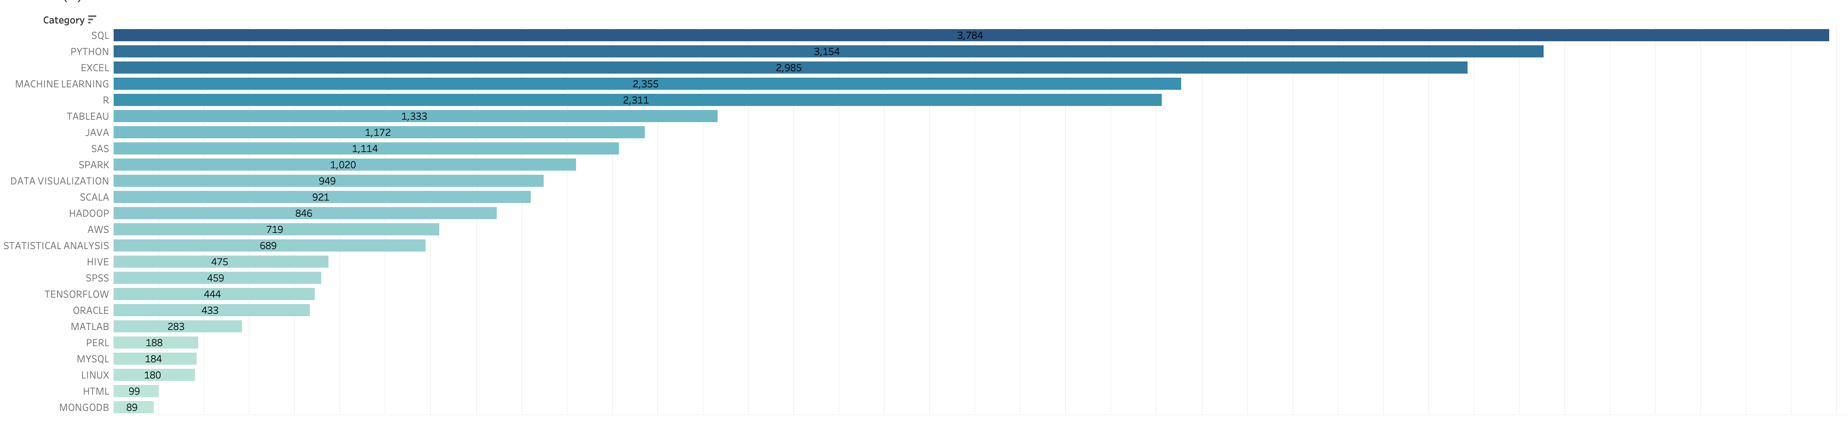
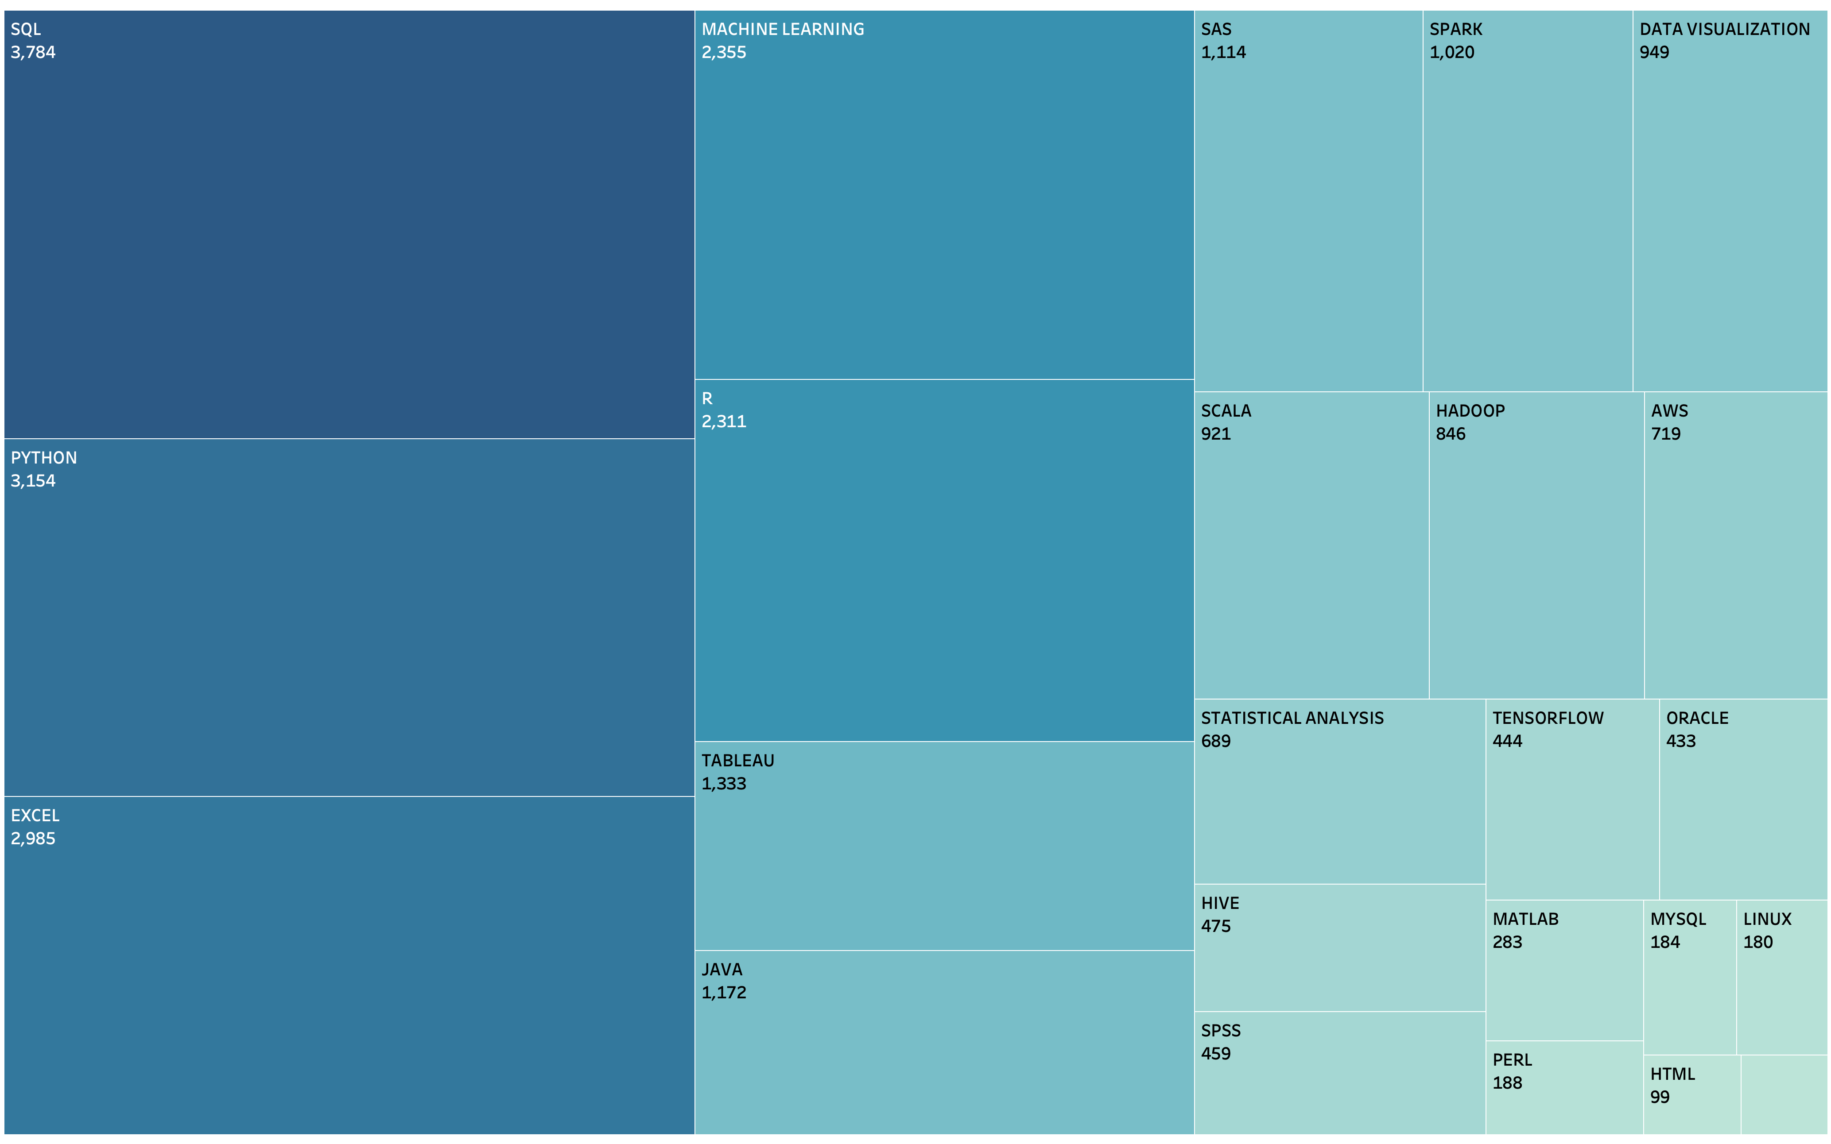
What Skill Sets are desired the most?
Top 5 skills are SQL, Python, Excel, Machine Learning and R for both Data Scientists & Data Analysts
Data Source: https://www.linkedin.com/jobs

Slide 7
Limitations
Observations
Customized job postings on LinkedIn may bias the data
While scraping top 5 cities for every state were considered due to limitations of 1000 hits per page
Data was scraped on March 3,2020. With Covid’19 situation requirements may have changed
Data Scientists & Data Analysts are need of the hour
Columbia University may re-evaluate their course structure
Focus your job search by filtering based on location preference, Industry Type and Skillset you possess
Do employers know their requirement?
Not Really!
Read Job description carefully
Thank you LinkedIn for not blocking my IP address!

Slide 8
Conclusion:
Increase Analytics Budget for Next Fiscal Year
Thank You!

